Slide 1

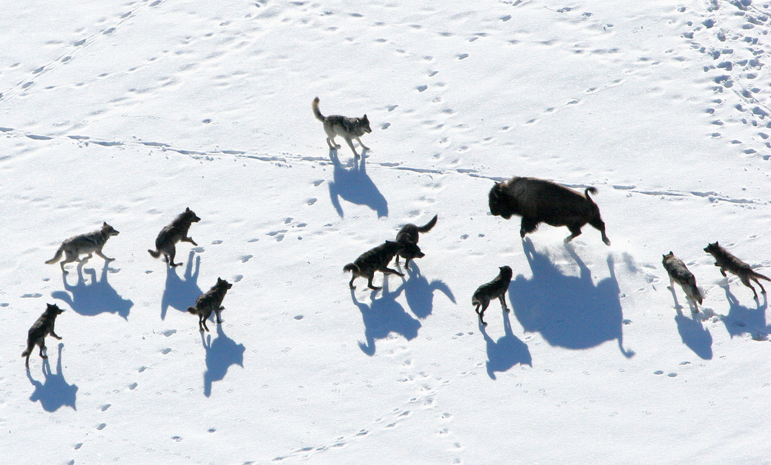
Binary Gray Wolf Optimization
Approaches for Feature Selection
Under the supervision of -
Submitted by -
Mr. Avinash Pandey
Suhani Kohli (9916103215)
Manika Kaushik (9916103099)
Kashish Chugh (9916103164)

Slide 2
Problem statement
Creating a variant of Grey Wolf Optimizer using Lévy Flight to overcome the problem of premature convergence to a local optima by enhancing the rate of exploration .
Feature selection using traditional search methods becomes a np-hard problem. Hence, suboptimal subsets are found by employing search algorithms which find a subset heuristically. The Grey Wolf Optimizer variant describes the enhanced version of binary Grey Wolf Optimizer and is used for selecting optimal subset of features.

Slide 3
State of the art
After the Grey Wolf Optimizer was discovered based on the nature, hunting and preying practices of the grey wolves, it was used for optimization of problems that have approximate solution (np-hard). Later, it found it’s application in feature selection technique where the binary version of the initial Grey Wolf Optimizer was used to select the optimal subset of features.

Slide 4
Limitations
The problem of local minima arises due to accelerated exploitation because of which premature exploitation takes place.
Follow the No-Free Lunch Theorem which states that a general-purpose, universal optimization strategy is impossible.

Slide 5
Objectives
The objective of our project is to create an enhanced binary version of the grey wolf optimization to find optimal regions of the complex search space. The aim of our project is to:-
To generate a variant of GWO
Use the variant of GWO to introduce an enhanced binary version of GWO to further improve results.
To use binary version of GWO for feature selection.

Slide 6
PROPOSED SOLUTION
In the standard GWO we see the problem of local optima arising due to accelerated exploitation because of which premature exploitation takes place. Hence, the solution does not provide the global minimum solution. To overcome this, Lévy flight has been used alongside to create the balance between intensification and diversification. A new variant of GWO, i.e., GWO-LF, is implemented in this project which will introduce some randomization on first best agent. This will enhance exploration.

Slide 7
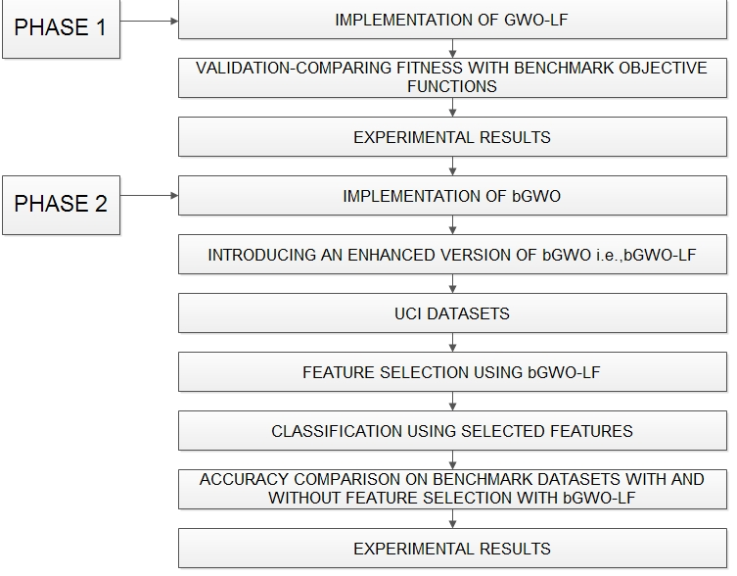
WORKFLOW

Slide 8
Results and Analysis
GWO has been tested on 14 benchmark functions including both unimodal and multimodal functions . Out of them we found 6 that performed best amongst them as shown in table below:
Fno. | Fname | GWO |  | GWO-LF
1. | Sphere | 6.59E-28 | 6.34E-05 | 2.15E-70 | 2.16E-21
2 | Schwefe13 | 7.18E-17 | 0.029014 | 9.04E-40 | 3.92E-13
3 | Schwefel4 | 5.61E-07 | 1.315088 | 1.54E-17 | 27.45E-05
4 | Rosenbrock | 26.81258 | 69.90499 | 26.3551 | 0.539162
5 | Quartic | 0.002213 | 0.100286 | 0.00058 | 0.002803
6 | New Schwefel | 6123.1 | -4087.44 | -1267.03 | 130.2414
7 | Rastrigin | 0.310521 | 47.35612 | 0.15143 | 4.997720
8 | Ackley | 1.06E-13 | 0.07783 | 20.28628 | 0.065616
9 | Griewank | 0.004485 | 0.006659 | 0.000742 | 0.0204229
10 | Penalty1 | 0.053438 | 0.020734 | 0.08857 | 0.1483137
11 | Penalty2 | 0.654464 | 0.004474 | 0.2440262 | 0.2631101
12 | Alpine | 2.15E-16 | 0.9823 | 1.66E-62 | 3.1140824
13 | Brown | 0.0272819 | 4.16E-22 | 9.12E-26 | 0.0887091
14 | Powell’s Second Singular | 1.92E-35 | 5.01E-09 | 9.35E-17 | 2.25 E-09

Slide 9
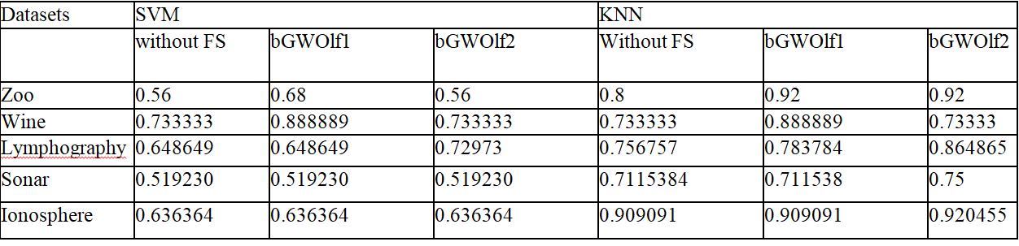
Average accuracy by different classifiers on datasets with and without feature selection
Analysis:
As seen in table above, the enhanced version of bGWO- GWOlf1 and bGWOlf2 selects minimal features and provides almost same accuracy, sometimes even better mean accuracy in case of SVM and KNN as compared to when classifier is fed with all the features of the dataset. This shows the efficiency of the model to reduce redundant and irrelevant features

Slide 10
Conclusion
GWO performs well but due to imbalance between exploration and exploitation it converges to local optimum solution. This problem can be solved by creating a variant in which randomization will aid in the balancing. With this objective in mind we have proposed a variant of GWO using Levy Flight.
Saving us from the exhaustive search of classical algorithms, the swarm intelligence meta-heuristic algorithms provide optimal results and one of these searches is feature selection where we have applied GWO to get the relevant set of features in a more efficient manner. The binary Grey Wolf Optimization has a room for improvement and so our aim will be to enhance the binary version of Grey Wolf Optimizer.

